Slide 1
4
Introduction to Hypothesis Testing

Slide 2
Inferential Statistics
Involve making inferences about populations based on information from samples (as compared to descriptive statistics, which merely summarize known information)

Slide 3
Inferential Statistics
Especially important because they provide a basis for drawing conclusions about the world in general (populations that cannot be measured as a whole) based on results from particular groups of people studied (samples)

Slide 4
Hypothesis Testing
Procedure for deciding whether the outcome of a study support a particular theory or practical innovation

Slide 5
Hypothesis Testing
Hypothesis – prediction, often based on information observation, previous research, or theory
Theory – set of principles that attempt to explain one or more facts or events

Slide 6
Core Logic of Hypothesis Testing
Hypothesis testing considers the probability that the result of a study could have occurred if the experimental procedure had no effect
If this probability is low, probability of no effect is rejected, and the theory behind the experimental procedure is considered to be supported

Slide 7
Hypothesis Testing
In English:
  Is our sample “weird”?
  How can you tell your sample is different?
Can’t PROVE anything

Slide 8
The Hypothesis Testing Process -1
Step 1. Restate the question as a research hypothesis and a null hypothesis about the populations
  Population 1
  Population 2
  Research hypothesis
  Null hypothesis

Slide 9
The Hypothesis Testing Process
Research Hypothesis – statement about the predicted relationship between populations
Null Hypothesis – statement about a relation between populations that is the opposite of the research hypothesis

Slide 10
One-Tailed and Two-Tailed Hypothesis Tests
Directional hypotheses
  One-tailed test
Nondirectional hypotheses
  Two-tailed test

Slide 11
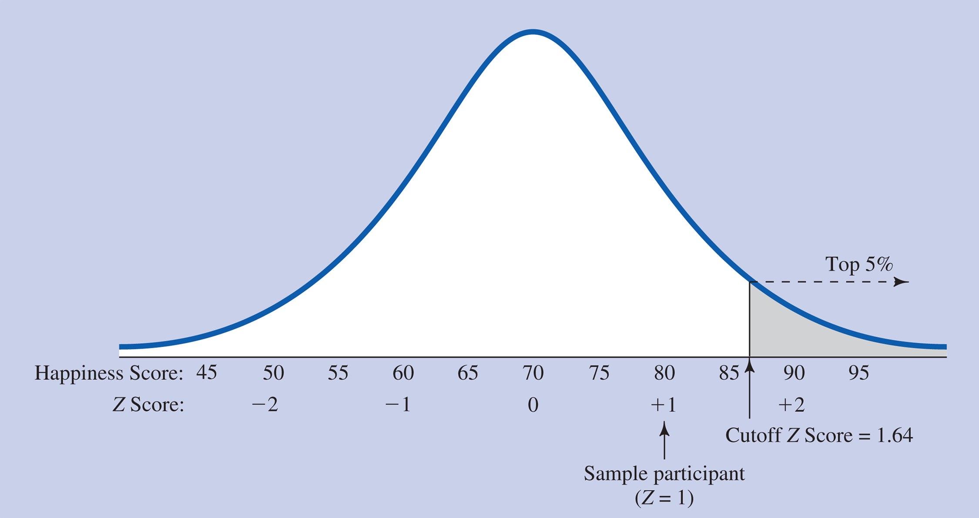
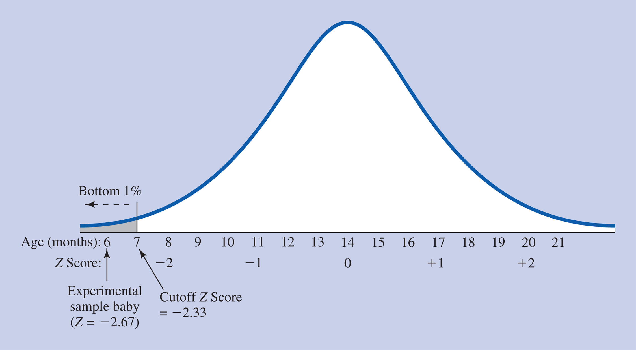
One-tailed Tests
Follow directional hypotheses because the direction of the result is predicted
.

Slide 12
One-tailed Tests
It is called a one-tailed test because the hypothesis test looks for an extreme result at just one end of the comparison distribution
.

Slide 13
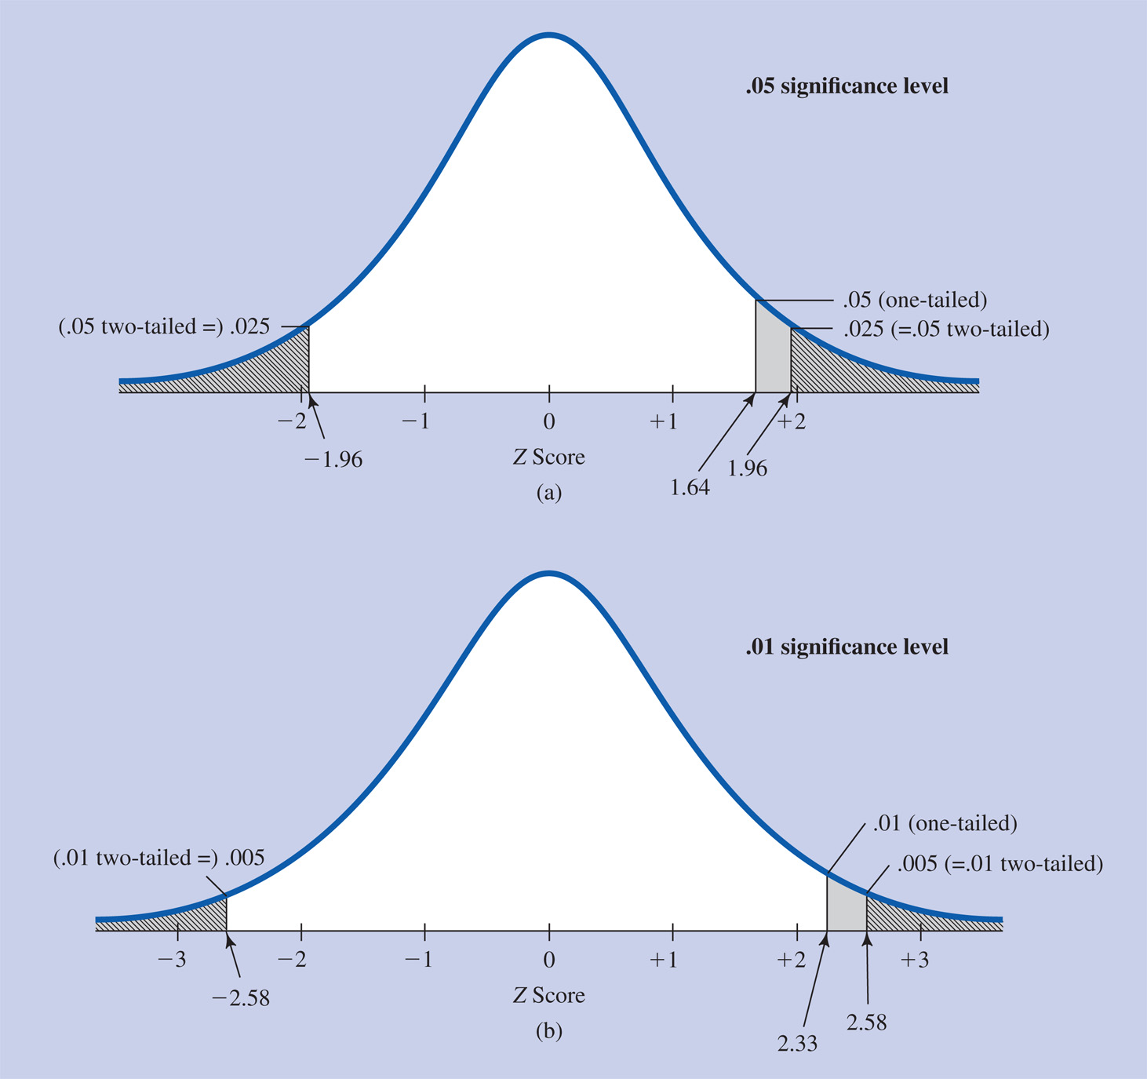
Two-tailed Tests
Follow nondirectional hypotheses because the direction of the result is not predicted

Slide 14
Two-tailed Tests
It is called a two-tailed test because the hypothesis test looks for an extreme result at either end of the comparison distribution

Slide 15
Using One- vs. Two-tailed Tests
If a one-tailed test is used and result is in the direction opposite from the predicted direction, no matter how extreme, it cannot be considered significant
Therefore, researchers generally prefer to use two-tailed tests except where it is very clear that only one direction of outcome would be of interest

Slide 16
Using One- vs. Two-tailed Tests
Some researchers, however, use one-tailed tests whenever there is any basis for making the prediction

Slide 17
The Hypothesis Testing Process -2
Step 2. Determine the characteristics of the comparison distribution
  Also called a sampling distribution
  In hypothesis testing, the actual sample’s score is compared to this comparison distribution

Slide 18
The Hypothesis Testing Process
Comparison distribution – represents the population if the null hypothesis were true
Compare your score to your sample results
Copyright © 2009 Pearson Education, Inc. Upper Saddle River, NJ 07458. All rights reserved.

Slide 19
The Hypothesis Testing Process -3
Step 3. Determine the cutoff sample score (critical value) on the comparison distribution at which the null hypothesis should be rejected

Slide 20
The Hypothesis Testing Process
Cutoff sample score – point on the comparison distribution at which you reject the null hypothesis
  Critical value

Slide 21
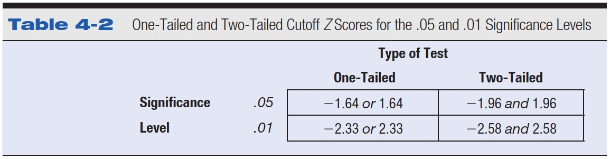
Table 4-2 One-Tailed and Two-Tailed Cutoff Z Scores for the .05 and .01 Significance Levels

Slide 22
The Hypothesis Testing Process -4
Step 4. Determine your sample’s score on the comparison distribution
  The sample score will be the statistics presented in this course

Slide 23
The Hypothesis Testing Process -5
Step 5. Decide whether to reject the null hypothesis
  If the sample score is more extreme than the cutoff sample score, the null hypothesis can be rejected – the experiment has had an effect
  If the sample score is not as extreme as the cutoff sample score, the null hypothesis cannot be rejected – the results are inconclusive

Slide 24
Controversies and Limitations
You are supporting the research hypothesis
  Not PROVING it
  We are dealing with probabilities – Its TRUE I can win the lottery, but the probability is very low
Copyright © 2009 Pearson Education, Inc. Upper Saddle River, NJ 07458. All rights reserved.

Slide 25
Controversies and Limitations
Criticisms of basic logic of significance tests
Misuse of significance tests
“... rigorous research requires continued use of significance testing in the appropriate context…and adherence to …recommendations that promote its rational use…” (Balluerka et al, 2005, p. 55)

Slide 26
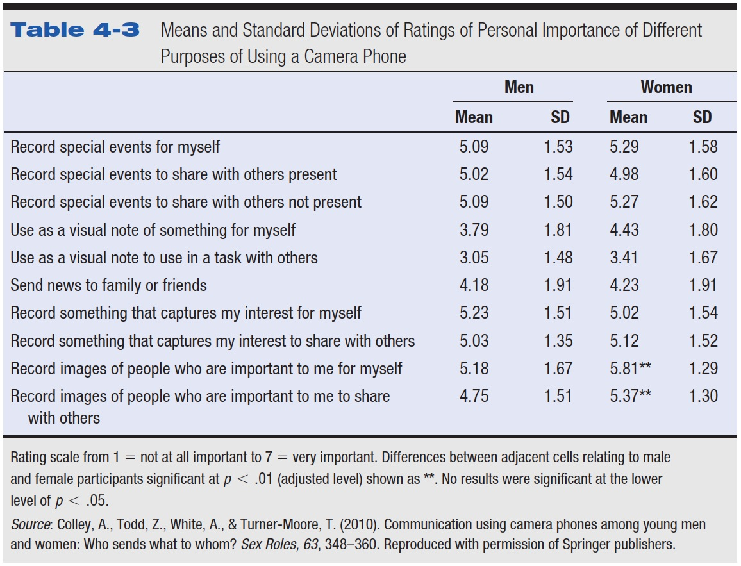
Table 4-3 Means and Standard Deviations of Ratings of Personal Importance of Different Purposes of Using a Camera Phone

Slide 27
Examples
In a study to see if children from lower socio-economic status (SES) neighborhoods have lower than average test-taking skills, a psychologist administered a standard measure of test-taking skills to a randomly chosen child from a low SES neighborhood and found him to have a score of 38. The average score on this measure for the population in general is 50 with a standard deviation of 10. Using the .05 level of significance, what conclusions should be drawn about whether children from low SES neighborhoods have lower test-taking ability?

Slide 28
Example
A popular music magazine has speculated that the average length of a song on one of today's popular CDs is 3.75 minutes with a standard deviation of .75 minutes. A randomly selected song of a particular new type of music is 5 minutes. Using the .05 level of significance, is this new type of music, represented by this one song, longer than popular songs in general?

Slide 29
Example
The general population (Population 2) has a mean of 30 and a standard deviation of 5, and the cutoff Z score for significance in a study involving one participant is 1.96. If the raw score obtained by the participant is 45, what decisions should be made about the null and research hypotheses?

